Slide 1
AI TA2 PROJECT
Objectives
Optical Character Recognition System
Image
01
Develop an automated OCR system to extract text from scanned documents and images
02
Transform unstructured image data into structured, machine-readable textual information
Preprocess
03
Implement a deep learning CRNN architecture combining CNN and Bidirectional LSTM layers
Recognize
04
Enable efficient, real-world processing of receipt documents and printed text
Output
05
Support downstream tasks including data analysis, digitization, and structured CSV export
01 / 06

Slide 2
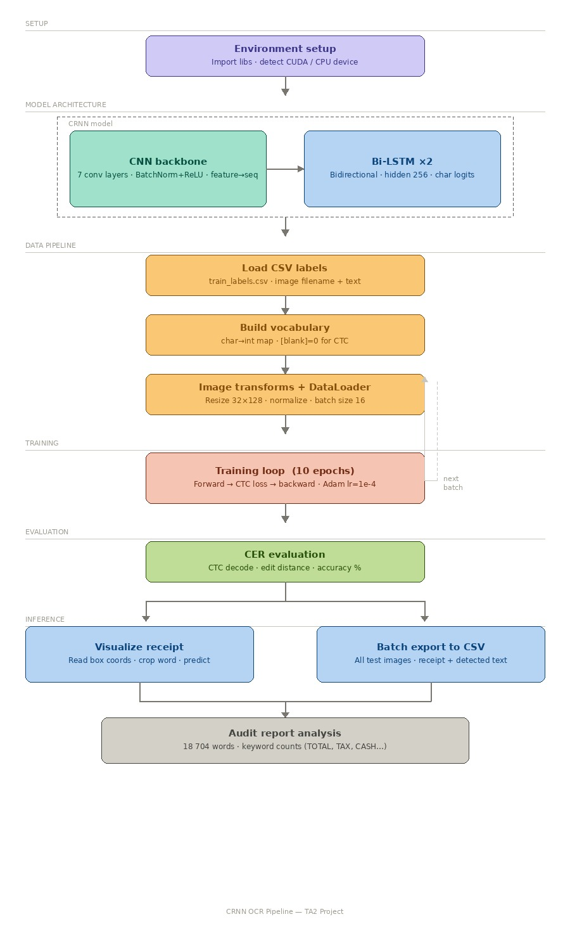
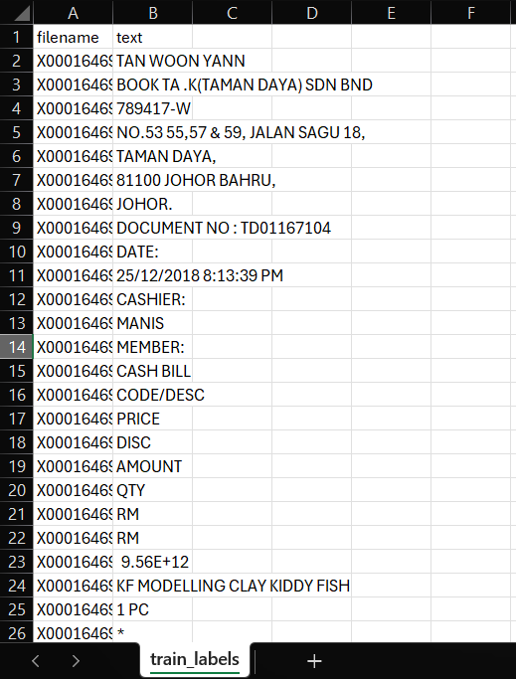
System Methodology
CRNN Pipeline Architecture
02 / 06
Dataset

Slide 3
Dataset & Implementation
SROIE Benchmark · PyTorch Framework
03 / 06
📂 SROIE Dataset
⚙️ Implementation Stack
Scanned Receipts OCR & IE Challenge dataset
Language
Python 3.x
Real-world receipt images with annotated ground truth
Framework
PyTorch
Covers font variation, layout diversity, and noise
Image Processing
OpenCV, PIL
Widely adopted OCR benchmark for document analysis
Numerics
NumPy
Supports text detection, recognition, and IE tasks
Architecture
CRNN (CNN + BiLSTM + CTC)

Slide 4
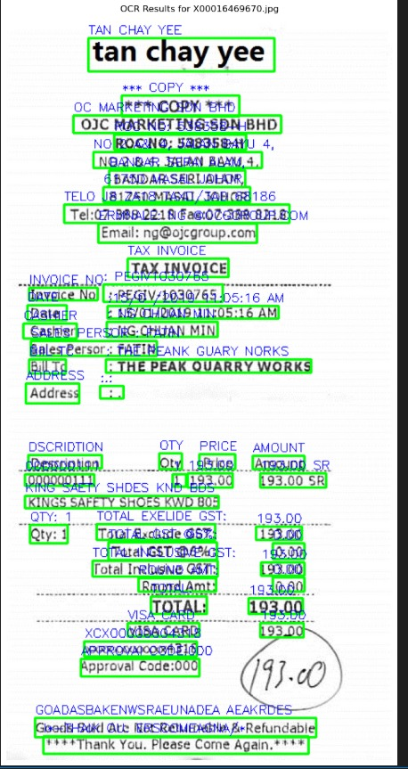
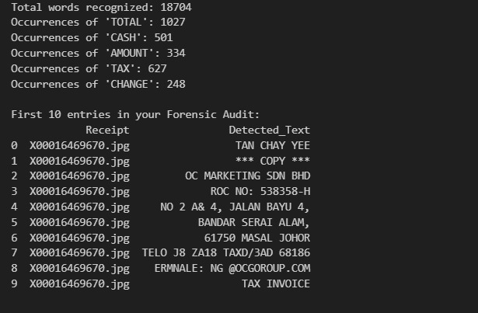
Results & Outputs
Empirical performance on SROIE benchmark
04 / 06
Result
Structured CSV Export
Extracted text organized into structured CSV rows
Fields: item name, quantity, price, total
Demonstrates practical document digitization
Enables downstream data analytics pipelines

Slide 5
Performance Evaluation & Limitations
CER Metric · Identified Constraints · Future Directions
05 / 06
Performance
Limitations
Future Scope
Metric: Character Error Rate (CER)
Degraded accuracy on noisy or blurry images
Adopt Transformer-based OCR models
Reliable accuracy on structured receipt data
Struggles with irregular or complex layouts
Improved preprocessing for robustness
Effective sequence modeling via CRNN
Requires large annotated datasets
Expand to multilingual text recognition
Stable training on SROIE benchmark
Limited multilingual text support
Deploy as API for production use

Slide 6
Team Contributions
Roles & Responsibilities — AI TA2 · April 2026
06 / 06
Adithiyan R S
Miracle Elliot Tettevi
AI engineering and launching
Data collection, selection and management; topic selection
Anjitha B
All Members
PPT, integration and
github management
Integration & Presentation

